Slide 1



Introduction to the library management system
A library management system is a software that helps in managing the different operations of a library. It includes book cataloging, check-in/check-out, managing user accounts, and more.
by santosh singh

Slide 2

Admin Registration Process
Credential Input
Verification
The admin provides necessary details for registration, including username, password, and email address.
Validation of admin credentials to confirm unique registration within the system.
Successful Registration
Confirmation message on successful registration and granting of admin privileges.

Slide 3
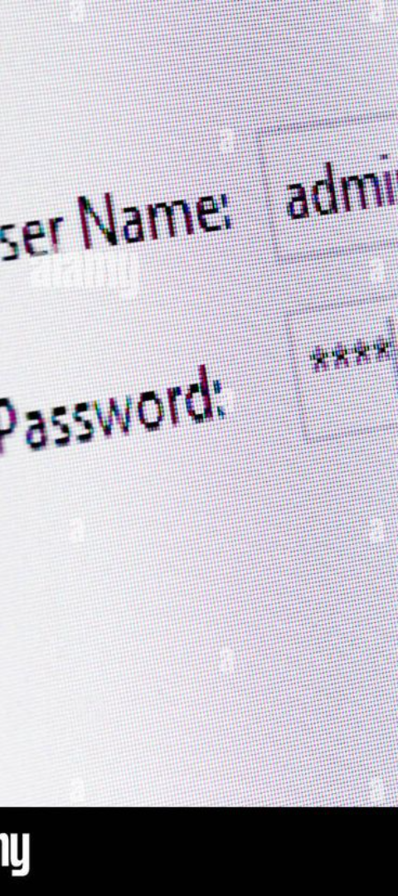
Admin Login Process
1
Username and Password
2
Authentication
The admin enters their unique username and password for system access.
Validation of admin credentials to grant access to the system's functionalities.
3
Dashboard Access
Upon successful authentication, the admin gains access to the dashboard for library management activities.

Slide 4
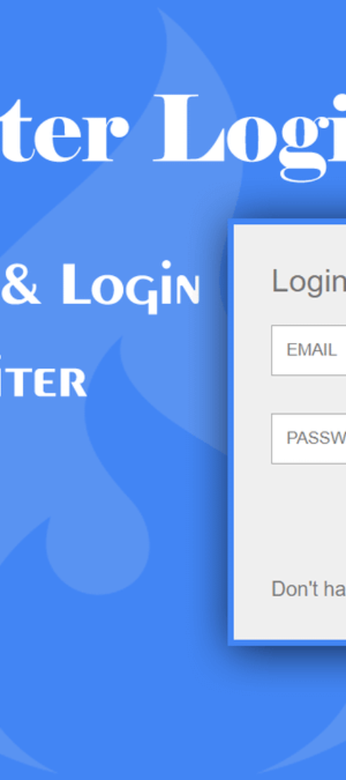
User Registration Process
1
Sign-Up Form
Users enter personal details and create a unique username and password.
2
Account Verification
The system validates the user's information and sends a verification email to ensure authenticity.
3
Registration Confirmation
Confirmation message after successful account creation within the library system.

Slide 5
Adding Books to the System
Book Details
ISBN Assignment
Shelf Allocation
Input of book information, including title, author, genre, and publication details.
Each book receives a unique International Standard Book Number (ISBN) for cataloging.
Assignment of library shelf location for easy retrieval and management.

Slide 6
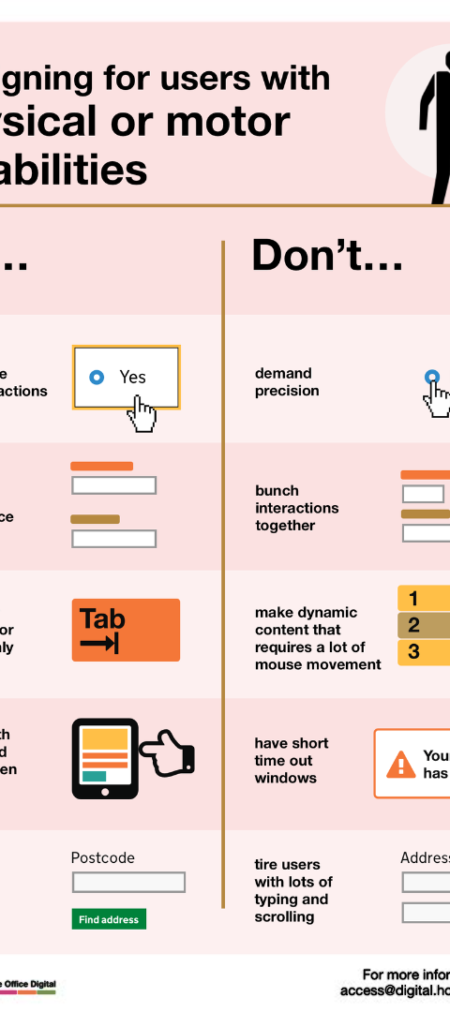



Issuing Books to Users
User Request
Users request books they wish to borrow, providing necessary details like book title and their account information.
Check Availability
Verification of book availability within the system's catalogue and shelf status.
Issuance Confirmation
Confirmation message after successful issuance of the requested book to the user.

Slide 7
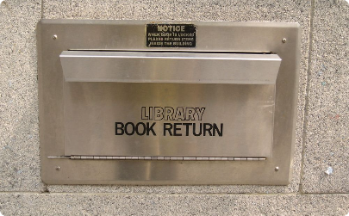
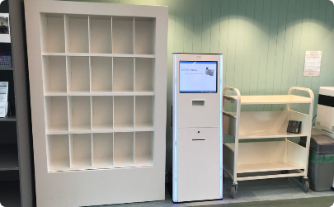
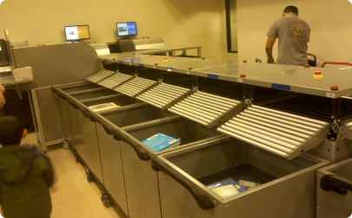
Returning Books to the Library
Book Inspection
Shelf Restocking
Update User Records
Users return books to authorized personnel for inspection and verification.
Once verified, the book is returned to its designated shelf location and marked available in the system.
System is updated to reflect the return of the book under the respective user’s account.

Slide 8
Displaying Available Books
Book Title
Author
Genre
The Great Gatsby
F. Scott Fitzgerald
Classic Fiction
To Kill a Mockingbird
Harper Lee
Legal Fiction
Pride and Prejudice
Jane Austen
Romantic Fiction

Slide 9
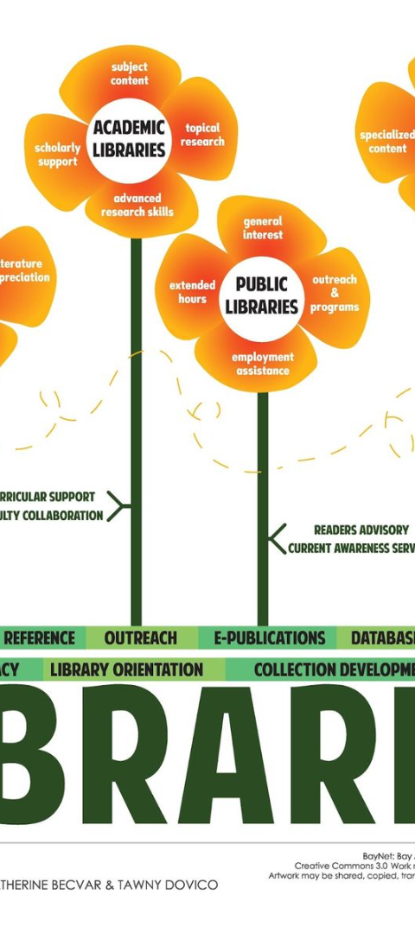
Managing User Accounts
1
User Records
2
Password Reset
Updating and maintaining user information including contact details and borrowed book records.
Requests for password resets and ensuring security of user accounts.
3
Account Deletion
Managing requests for account closure and removal of user details from the system.

Slide 10
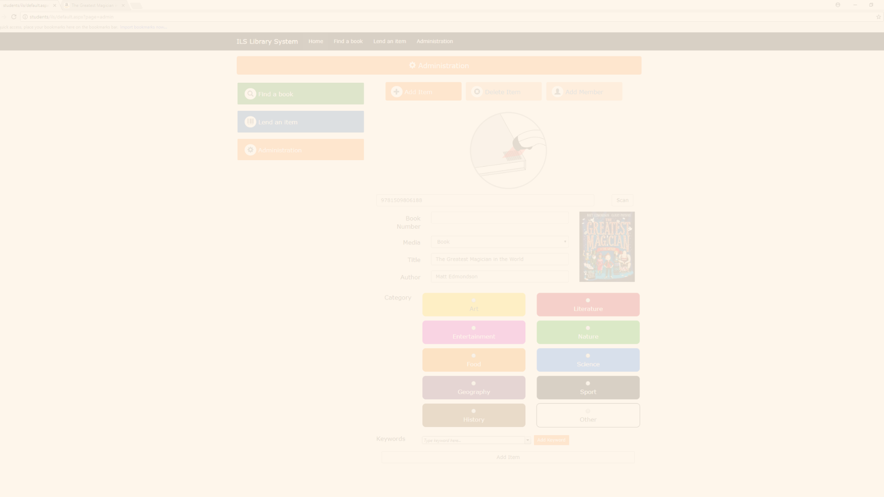
Conclusion and Next Steps
Future Development
User Feedback
Implementation Plan
Discussing potential updates and systems enhancements for improved library management.
Evaluating user experiences and feedback for refining and further developing the system.
Outlining the roadmap for implementing changes and integrating new features into the system.

